Slide 1
Addressing Quality in Childcare: A Case Study of A Community Wide Approach to Improve Outcomes for Children in a Disadvantaged Area
Jenna Russell, Project Leader
Barnardos Brighter Futures, Knocknaheeny, Cork, Ireland

Slide 2
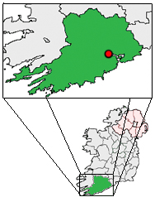
Location
Cork city
population 119, 230
YK Catchment area
population 12,000
children <15yrs 5177
children 0 – 6 yrs 1155
(Source CSO Census 2011)

Slide 3
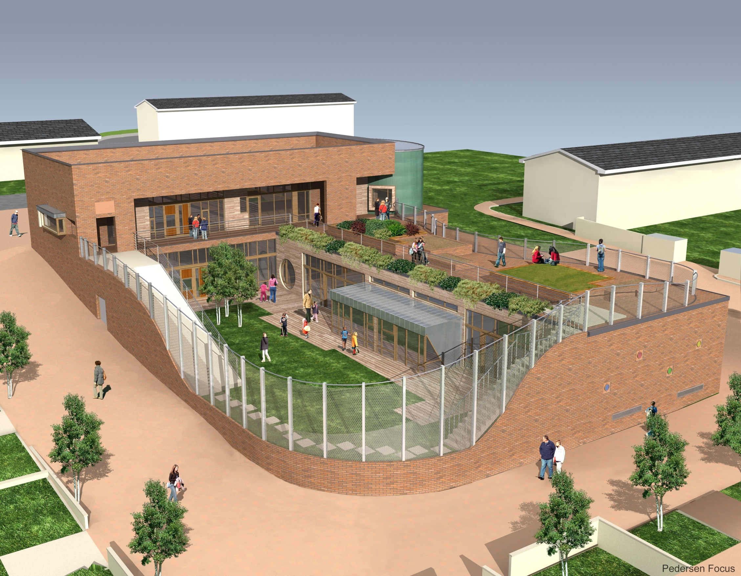

Slide 4
Child poverty
Poverty, particularly in the early years, impacts on all aspects of a child’s life (Duncan et al., 2012).
Early childhood development is negatively impacted with lasting effects into adulthood and beyond to the next generation.
This intergenerational transmission of disadvantage is more pronounced in liberal economies such as Ireland and the UK than in social democracies (Whelan et al., 2013).
In 2015, 11.5% of children in Ireland (aged 0-17) lived in consistent poverty (Barnardos 2016).
Notes:
Duncan, G. J., Magnuson, K., Kalil, A., & Ziol-Guest, K. (2012). The Importance of Early Childhood Poverty. Social Indicators Research, 108(1), 87-98.
Whelan, C., Nolan, B., & Maitre, B. (2013). ANALYSING INTERGENERATIONAL INFLUENCES ON INCOME POVERTY AND ECONOMIC VULNERABILITY WITH EU-SILC. European Societies, 15(1), 82-105. doi: 10.1080/14616696.2012.692806
Barnardos (2017) www.barnardos.ie
Young Knocknaheeny Area-based Childhood Programme http://youngknocknaheeny.ie/

Slide 5
Young Knocknaheeny Area Based Childhood Programme (YK)
A multi-disciplinary area-based prevention and early intervention partnership which aims to get every child’s life off to the best possible start by:
Respectfully enhancing the knowledge and skills of all parents and practitioners
Strengthening and enhancing all relationships and environments that are important to children
Embedding systems and community change to address childhood poverty and support early childhood development

Slide 6
YK Interconnected strategies
Capacity Building
Integration
Quality Improvement
Infant Mental Health and Wellbeing
Speech, Language and Literacy
Early Childhood Care and Education
Prosocial Behaviour and Self-Regulation
Underpinned by Interdisciplinary Infant Mental Health Framework
Supported by an integrated Research and Evaluation
Notes:
1: Infant Health and Wellbeing
-Pre-birth to 3 years invitation to all parents to register with Young Knocknaheeny (YK) Programme
-Pre-Birth Home screen: Incorporated Psychological assessment of preparation for parenthood
-Pre-birth to 3 years interdisciplinary home visiting programme informed by Michigan Infant Mental Health (IMH) Home Visitation Model with external consultation provided by Michigan Association of IMH
-Interagency Wrap-Around Model for interdisciplinary family work
-IMH Reflective practice supervision (YK Staff)
-IMH Consultations available to practitioners and services
-Environments of continuous learning: IMH 2 day Masterclasses in communities and in-service training, followed by sustainable monthly interdisciplinary practitioner network meetings.
-Education and Training to modules to undergraduate and postgraduate health and social sciences.
-Supports to Kidscope Community Child Development Assessment Clinic incl. Registration of families to YK Programme; Clinic process documentation; Clinic Administration.
-Universal Transition to Parenthood Group: 6 weeks psychological preparation programme for expectant parents in partnership with North Cork Infant Mental Health Network
-PEEPS Learning Together Programme Leader Training and Facilitators network; co-facilitated Parent and Child 0-years Programme
-Elklan Lets Talk with your Baby Group 3-12 months
-Baby Massage
2. Speech, Language and Literacy
-Babbling Babies universal communication session with parents and 9month baby in conjunction with Public Health Nurse Development Check Up Clinics
-Whole community Junior Infant Speech & Language Assessments and follow up in all 4 primary schools
-Contributing to 0-3 interdisciplinary IMH home visitation model and Kidscope Interdisciplinary referrals.
-Training and facilitation support for Elklan Lets Talk with your Baby Group 3-12 months
-Delivering Early Years Hanen ‘Learning Language & Loving It’ programme
-Delivering Junior Infant teacher Hanen “ABC” Programme
-Provision of oral language development training to YK team members & supporting implementation of Elklan Let’s Talk with your Baby group
-Cross- service implementation groups
Training and Education modules to undergraduate and post-graduate health and social sciences
-Oral Language Community/Service Consultations
Clinical Governance / Supervision provided by HSE Cork North Speech and Language Department.
3. Early Childhood Care and Education
-Children 18months to 5 Years benefiting from a local Early Care and Education setting involved in ongoing whole community quality improvement strategy
-Early Years ECERS and ITERS assessments and reports for all rooms pre and post YK quality improvement programme
-Highscope curriculum training for Crèche and Preschool Staff
-Montessori Masterclasses
-On Site specialist implementation mentoring within National Framework Standards
-Environmental enhancement supports
-Skills development for staff supervision
Developing and sustaining an Early Years Managers Forum
-Implementation of standardised transition tools for children entering preschool and primary cycle.
-Local promotion of Early Years Centres in their contribution to children’s early education and development
-Developing co-ordinated strategies for greater parental involvement.
C0-ordinated by Barnardos Brighter Future Centre, supported by child care service co-ordinators implementation group and Cork City Childcare Company.
4. Pro-Social Behaviour and Self-Regulation
-Whole community approach to the delivery of Incredible Years Programmes.
-Incredible Years Teacher Classroom Management Training across 4 primary schools
-Incredible Years Basic Parent Leader Programme Training for practitioners across 9 organisations
-Incredible Years Whole Classroom Dina Programme Training across 4 primary schools
-Incredible Years Basic Parent Programme 2-4 years and 5-8 available to all parents in catchment area
-Co-ordinated by the local School Completion Programme
-Training and mentoring provided by Archways.
-IY Parent Leader Facilitators Peer Group: Supporting roll out of parent programme, promotion, referrals, preparation of participations, logistics.
-Working toward facilitator accreditation, mentoring and training delivery.

Slide 7
Sample of data sources
Small area statistics from 2011Census (Cork City Council)
Micra-T - Reading level attainment Standardised testing in Irish Primary Schools obtained from Primary Schools
Data collected by the YK:
Strengths and Difficulties Questionnaire (SDQ) teacher-completed (Junior Infants in Primary Schools)
Pre-school Language Scale 5th Edition (PSL-5) Clinical testing of Junior Infants by YK Oral Language Officers
Early Childhood Environment Rating System (ECERS) external independent assessment of child care settings

Slide 8
YK catchment area demographic profile (Total population 12,000)
 | YK catchment area (% population) | Ireland (% population)
Post secondary education (≥15 years) | 17% | 44%
Unemployed | 30% | 15%
Renting from Local Authority | 38% | 8%
Ethnicity – White Irish | 90% | 85%
Private households with Children | 52% | 49%
Children under 15 | 21% | 21%
Families with children under 15:
Couples with Children | 45% | 78%
Lone mothers | 54% | 21%
Lone Fathers | 1.5% | 1.5%
Notes:
No change

Slide 9
Literacy
MICRA-T (Mary Immaculate Reading Attainment Test)
Standardised reading test used across Irish primary schools
Results presented by 20th percentile (based on the scores of 10,000 pupils in the 2002-2003 school year).
Not routinely available for research purposes but aggregated results provided by 3 schools to YK

Slide 10
Micra T Class-based Scores across 3 schools in 2014 (n = 429 students)

Slide 11
Speech & Language Difficulties PLS5 May/June 2015 (n=117 Junior Infants in 4 schools)

Slide 12
Early Years Service Quality (2015)
ECERS Score
1 = inadequate
3 = minimal quality
5 = good
Notes:
Rooms include both toddler/crèche rooms and preschools rooms
Generally, A score of 1 is defined as inadequate, 3 is defined as minimal quality, and 5 is defined as good (hence
scores of 5 or above are good or better). One interpretation of these scores is that anything below a 3 is
unacceptable and scores below 5 are not consistent with expectations for a high-quality program.
Aplus Education (UK)

Slide 13
A Community of Early Years settings driving an ongoing evidence informed quality improvement strategy
35 staff, 350 children
Community Montessori preschool (with High/Scope crèche)
School Early Start
Community settings using play based approach
Targeted Early Intervention Centre

Slide 14
Early Years Care and Education
High/Scope curriculum training
Montessori Masterclasses/site visit/mentoring
On Site specialist mentoring
Hanen Learning Language and Loving It
Environmental enhancement fund
Transitions/Supervision focus
Increased Parental Engagement and supports
Within Aistear/Siolta Framework

Slide 15
Learning to date
High/Scope curriculum training with mentor implementation has had the biggest impact on quality improvements in centres
Mentor is KEY- trained in High/Scope with practice expertise, able to support the individual, the room and the centre. Time to build a relationship, skilled at naming challenges and what to work on

Slide 16
Schweinhart 2010 “To get what we got, you've got to do what we did, - invest in quality practice - and what we did may look expensive. Specifically, highly effective early years programmes must have qualified teachers who learn and use a validated interactive child development curriculum like High/Scope and who develop partnerships with parents”

Slide 17
Thank You

